Slide 1

Supervised Machine Learning: Classification Algorithms
Namig Abbasov
Data Science and Analytics

Slide 2
Couple of Notes
Will cover some classification algorithms
Coding them
As much as our time allows
Will include additional resources in GitHub
Make an appointment: datascience@asu.edu or Namig.Abbasov@asu.edu

Slide 3
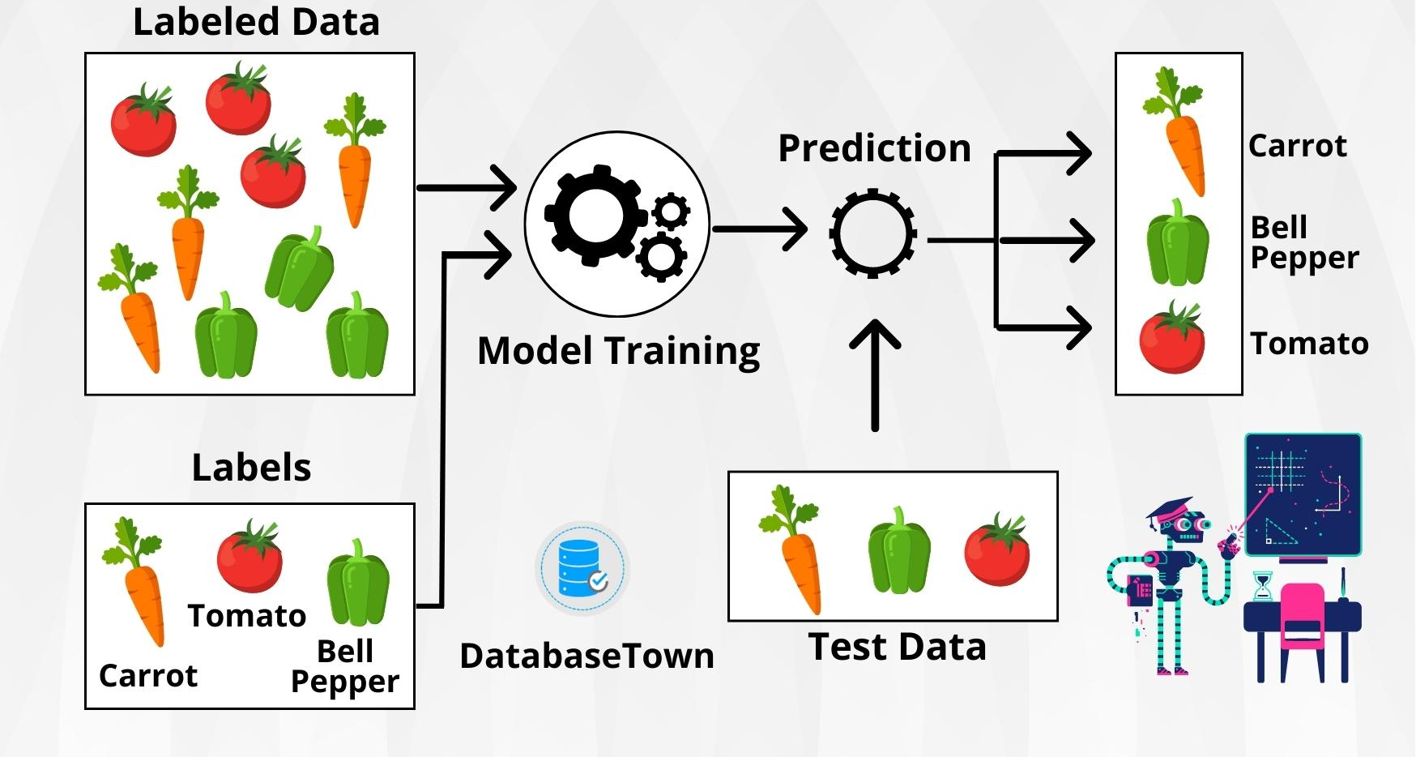
Supervised Machine Learning Reminder

Slide 4
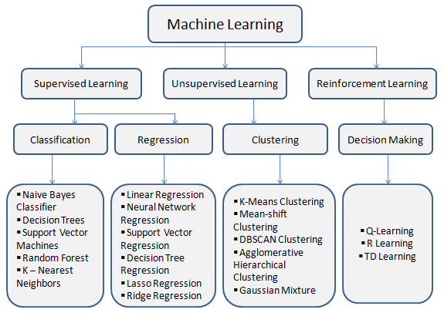
Notes:
https://medium.com/@venunagender2111/what-is-machine-learning-0583ca054e52

Slide 5
When to Use Classification Algorithms?
Decision-making rather than estimation
1
Binary classification
2
Image classification
Loan approval
Ham or spam
Sports predicting: win or lose
Multiclass Classification
3
Disease diagnosis (Covid vs viral vs bacterial)
Identifying Anomalies or Rare Events
4
Fraud Detection
Network intrusion detection(normal traffic vs. attack)
Medical Diagnosis and Healthcare Predictions
5
Cancer, CKD, Diabetics
Sentiment Analysis
6
Negative, positive, neural
Text Classification
7
Sports, political, entrainment
Speech and Audio Classification
8
Customer Behavior
9
Churn
Risk Assessment
10
High risk, low risk
Will buy our products/services?

Slide 6
Classification Intuition
Var1 | Var2 | Var3 | Var4 | Var5 | Var6 | Var7 | Var8 | Var9 | class
94.99 | 105.35 | 10.56 | 10.45 | 105.46 | 106.34 | 107.39 | 109.22 | 101.22 | 1
9.55 | 10.35 | 100.56 | 100.45 | 10.55 | 55.49 | 10.21 | 10.44 | 10.25 | 0
9.77 | 10.35 | 100.56 | 100.45 | 10.46 | 10.34 | 10.39 | 10.22 | 10.22 | 0
94.96 | 105.35 | 10.56 | 10.45 | 105.46 | 106.34 | 107.39 | 109.22 | 101.22 | 1
94.98 | 105.35 | 10.56 | 10.45 | 105.46 | 106.34 | 107.39 | 109.22 | 101.22 | 1
9.90 | 10.35 | 103.56 | 104.45 | 10.46 | 10.34 | 10.39 | 10.22 | 10.22 | 0
94.99 | 105.35 | 10.56 | 10.45 | 105.46 | 106.34 | 107.39 | 109.22 | 101.22 | 1
Var1 | Var2 | Var3 | Var4 | Var5 | Var6 | Var7 | Var8 | Var9 | class
99.90 | 106.50 | 9.88 | 10.43 | 102.42 | 107.35 | 109.55 | 107.47 | 109.22 | ??
8.55 | 10.39 | 101.50 | 102.52 | 11.57 | 53.96 | 12.45 | 9.42 | 14.01 | ??

Slide 7
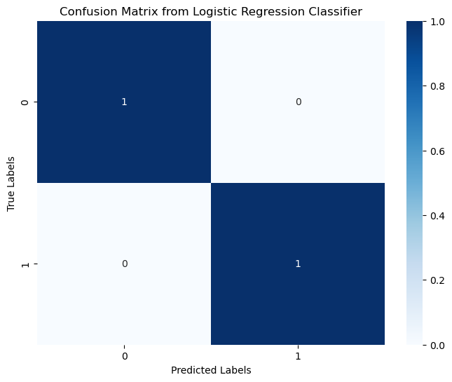
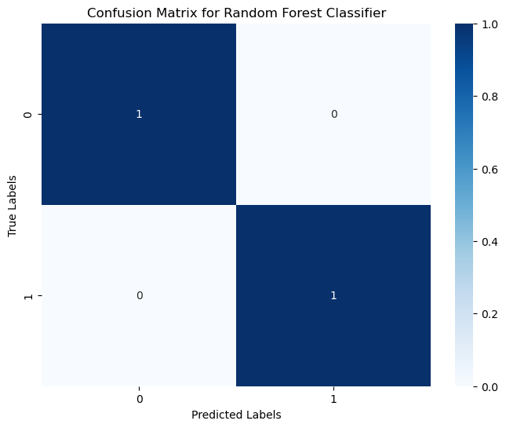

Slide 8
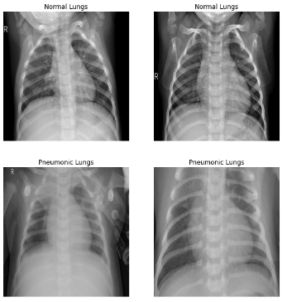
Normal
Which of these X-Ray Scans are Images of Pneumonia?
Pneumonia

Slide 9
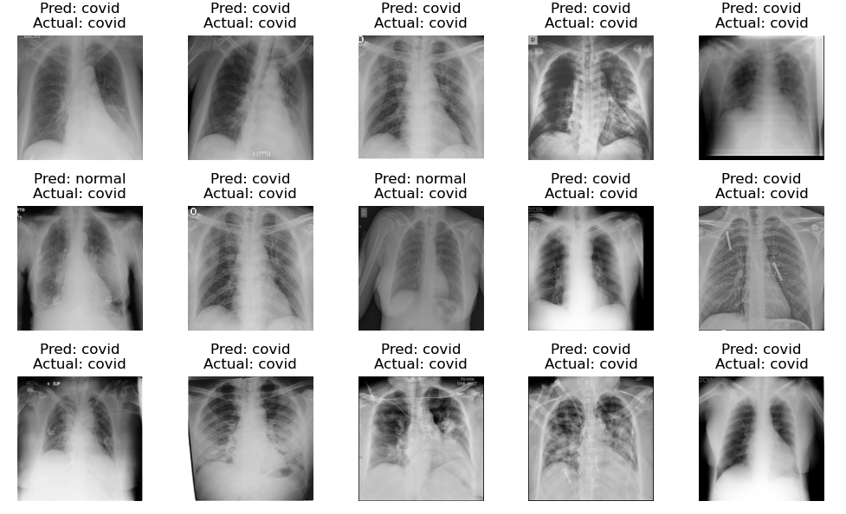

Slide 10
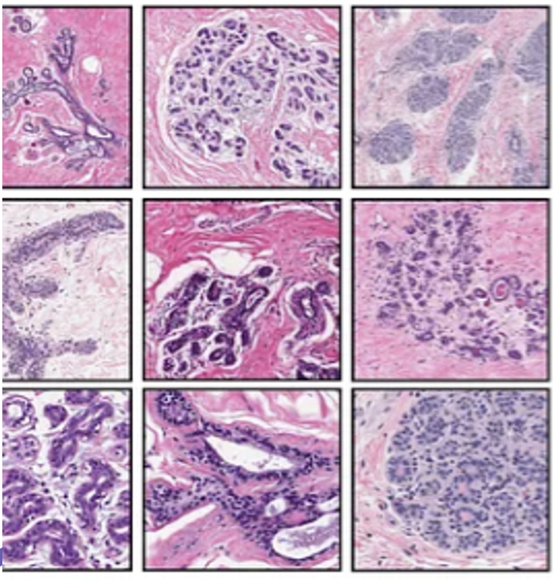
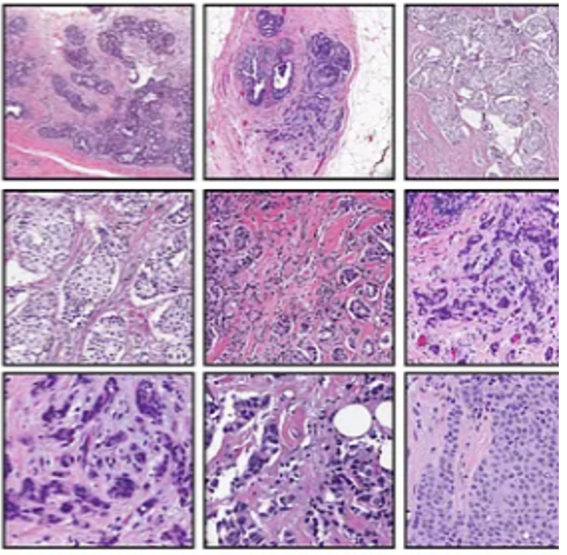
Which of digitized images of fine needle aspirates (FNA) from breast masses are malignant?
Benign
Malignant

Slide 11
Top Machine Learning Algorithms for Classification
Logistic Regression Classifier
Decision Tree Classifier
Support Vector Machines(SVM)
K-Nearest Neighbors (KNN)
Ensemble Classifiers
Random Forest

Slide 12
Logistic Regression
Define Problem: Will It Rain Today? 🌧️☀️
Humidity
Wind Speed
Temperature
Cloud Cover
Define Problem: Predicting Loan Approval ✅ ❌
Income
Credit Score
Employment Status
Debt-to-Income Ratio
Define Problem: Will I Pass Exam? 😊😢
Study Hours 📚
Attendance ✅
Previous Test Scores 📊

Slide 13
When to Use Logistic Regression?
Binary or Categorical Dependent Variable
Independence of Observations
Linearity of logit
No Perfect Multicollinearity

Slide 14
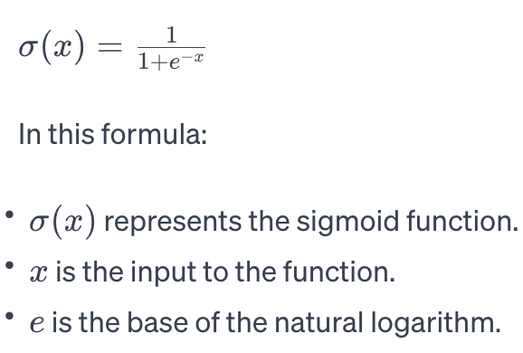
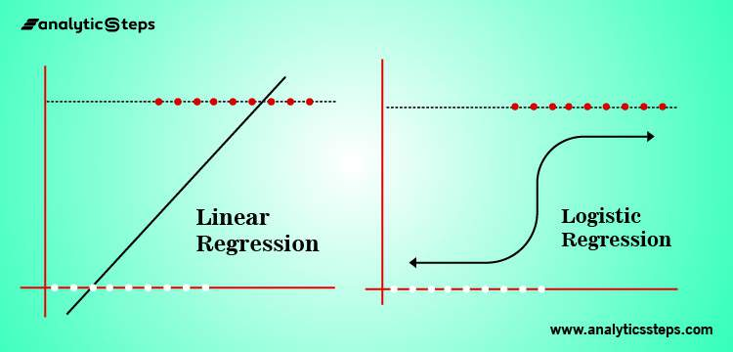
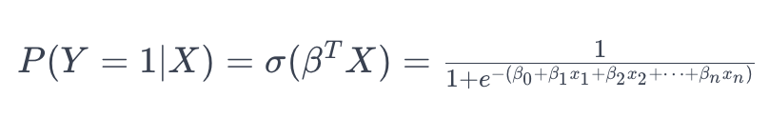
Logistic Regression Classifier

Slide 15
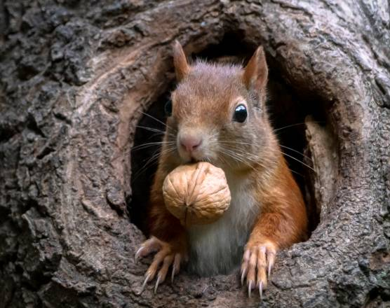

Decision Trees: Develop Model to Find Squirrel on Tree

Slide 16
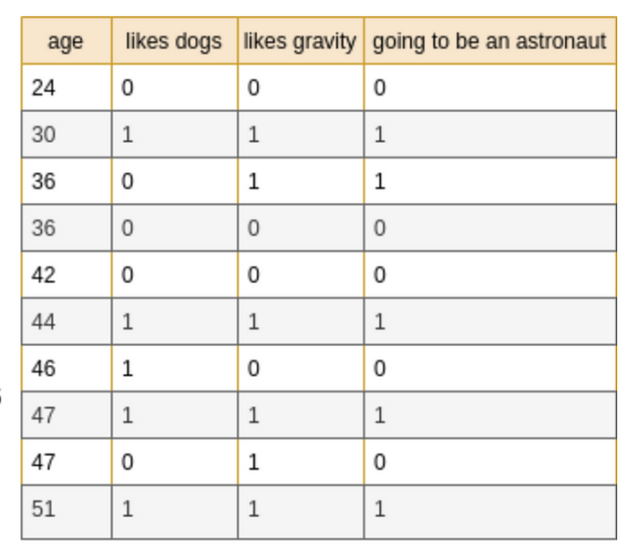
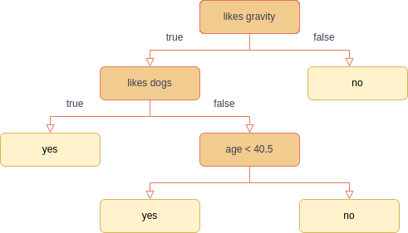
Decision Trees

Slide 17
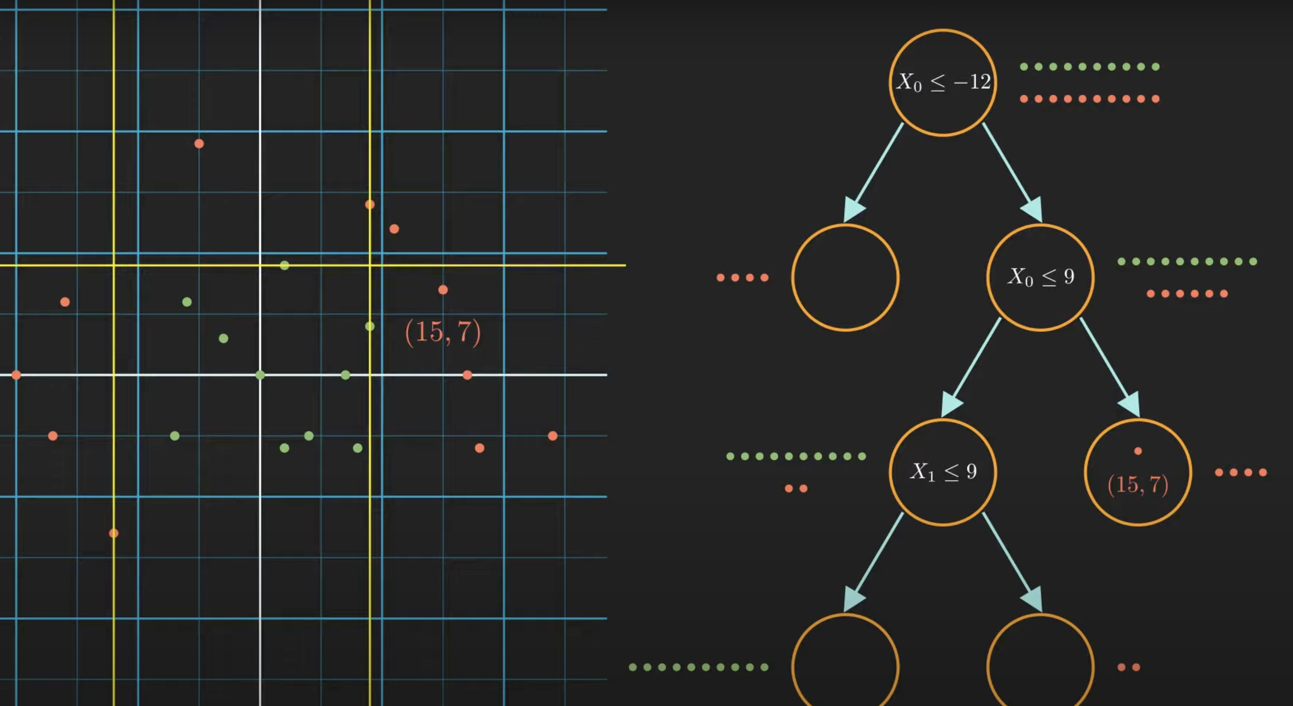
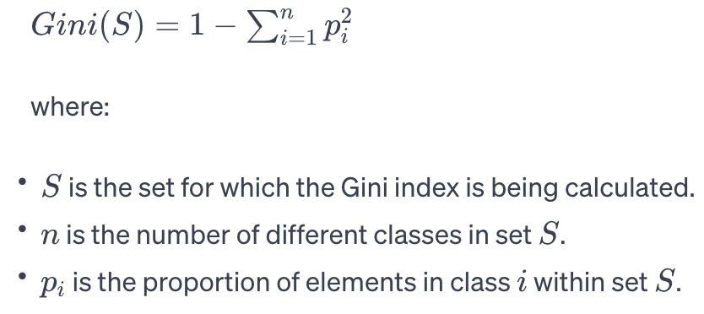
Decision Tree Classifier
X0 | X1 | Target
15 | 7 | darkorange
White Box
Measures in Decision Trees
Information Gain
reduction in entropy
Gini Index or Gini Impurity

Slide 18

Random Forest
Ensemble Learning
Bagging
Boosting
stacking
Random Forest is Bagging
Bootstrap
Aggregating

Slide 19
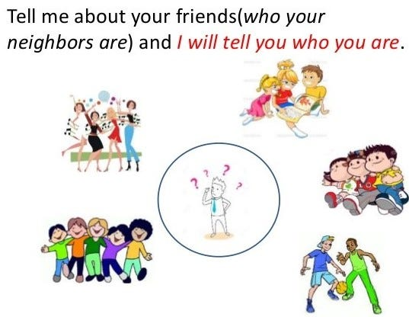
K- Nearest Neighbors

Slide 20
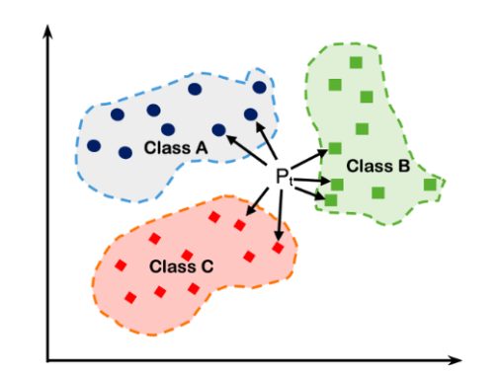
K-Nearest Neighbors (KNN)

Slide 21
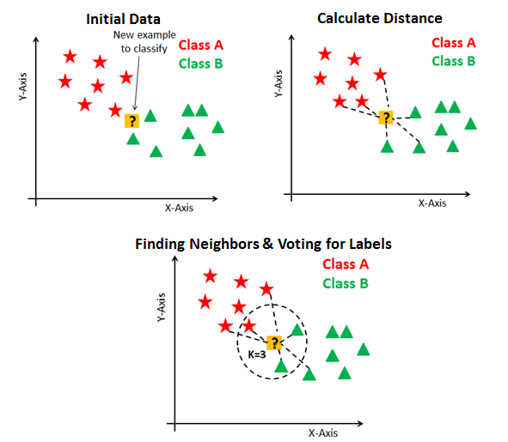
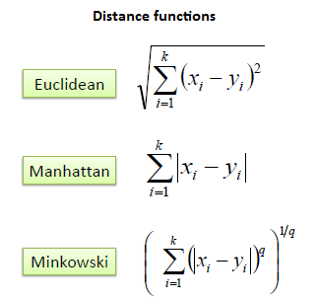
KNN

Slide 22
When not/to Use KNN?
Use
Lazy Learner
Low dimensionality
Medium range datasets
Non-Linearity
Interpretability
Multi-class classification
Unknown Data Distribution
Not use
Large Datasets
High-Dimensional Data – Dimensionality Curse
Imbalanced Data

Slide 23

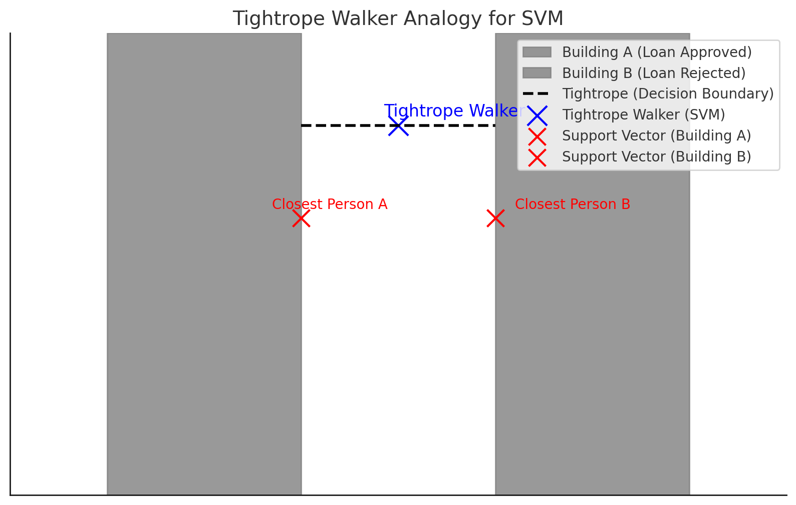
Support Vector Machines

Slide 24
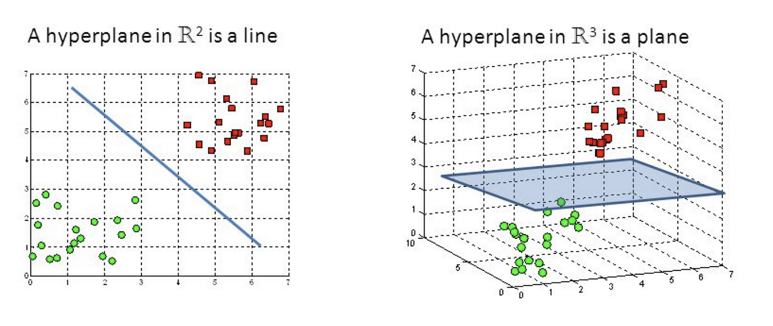
Support Vector Machines(SVM)

Slide 25
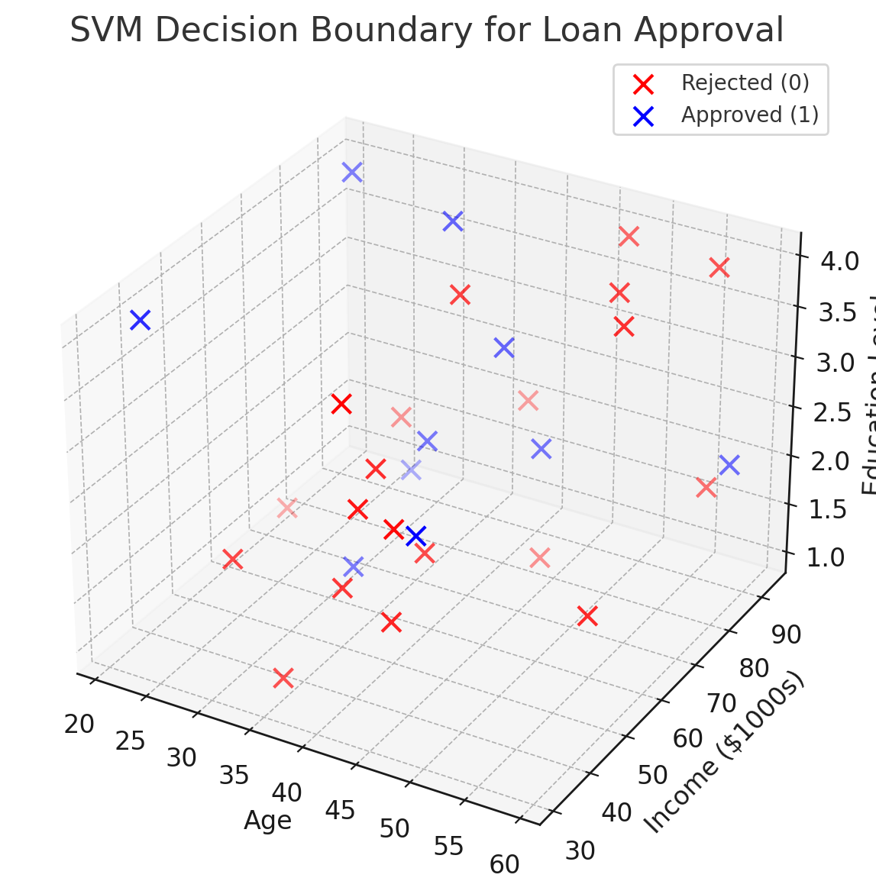
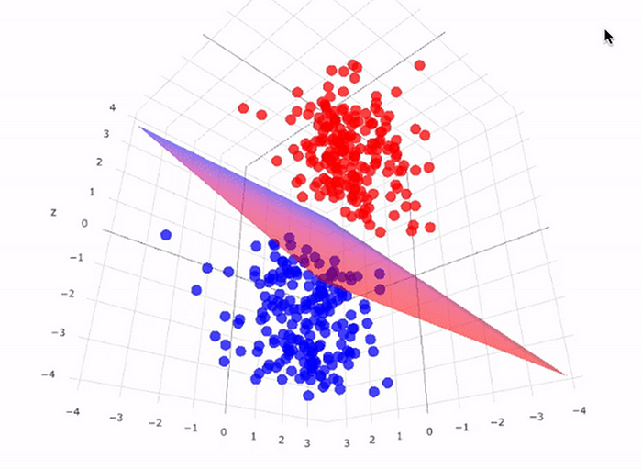
Building Loan Approval Model

Slide 26
When to Use Support Vector Machine (SVM)
Use
Binary Classification Problems
Medium or Small Dataset
High-Dimensional – text classification
Linearly Separable (use Kernel Trick if not)
Overfitting
Not Use
Big Data
Highly Noisy Data
Multi-class classification
Interpretability

Slide 27
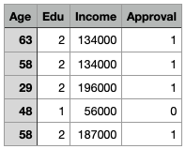
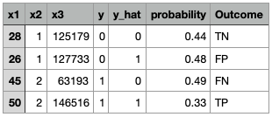
Model Evaluation on Test Data
True Positive (TP): correctly indicates presence of a condition.
True Negative (TN): correctly indicates absence of a condition.
False Positive (FP), Type I Error: wrongly indicates that particular condition or attribute is present.
False Negative (FN), Type II Error: wrongly indicates that particular condition or attribute is absent.

Slide 28
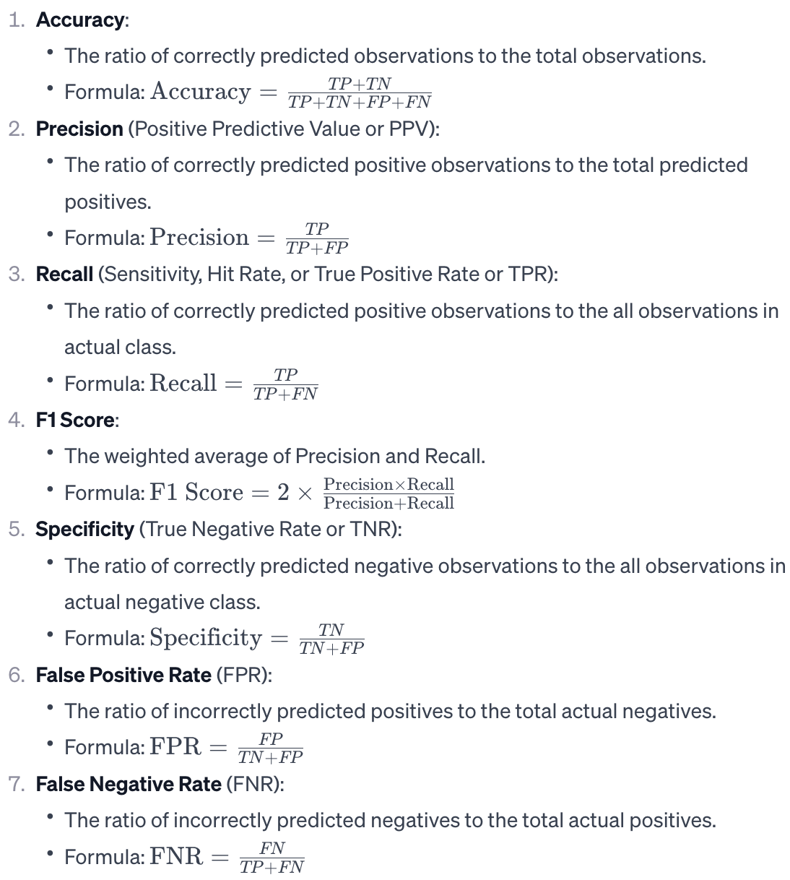
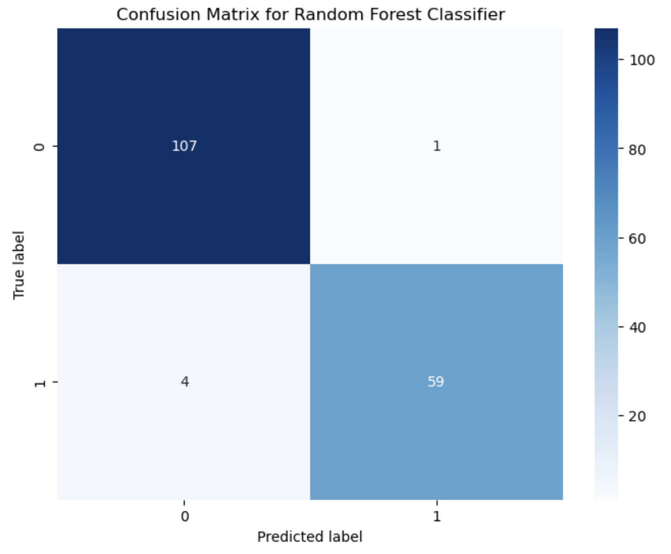
Confusion Matrix

Slide 29
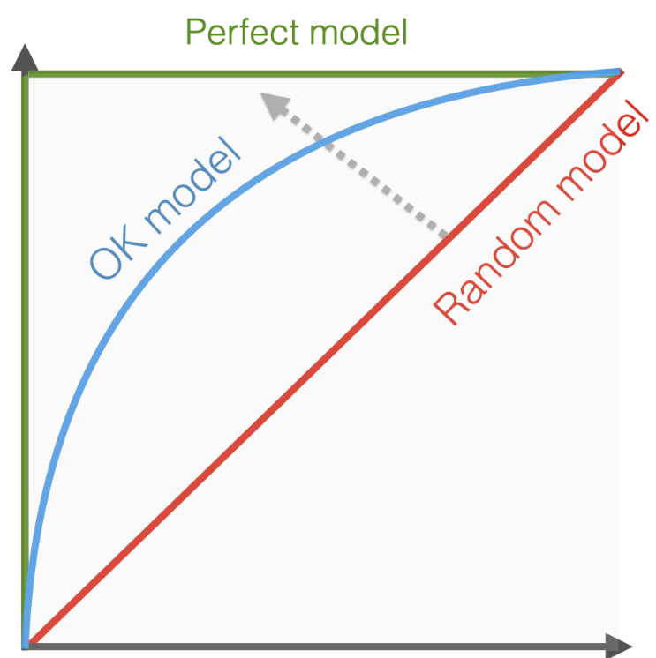
Receiver Operating Characteristic (ROC) Curve and ROC Area Under Curve(AUC) Score
Ideally, we need higher recall and lower False Positive Rate
Trade-off: when recall goes up(as we decrease threshold), so does False Positive Rate
Examples: credit card fraud detection(vacation), breast cancer
Random Model (AUC ~ 0.5): Performance similar to random guessing.
Acceptable Model (AUC ~ 0.8): Improved performance, targeting a specific AUC of 0.8.
Great Model (AUC ~ 0.9): High-performing model with a very good AUC.
Perfect Model (AUC = 1.0): Ideal model with perfect classification.
Sensitivity Recall, True Positive Rate
False Positive Rate
Copyright: Evidently AI

Slide 30
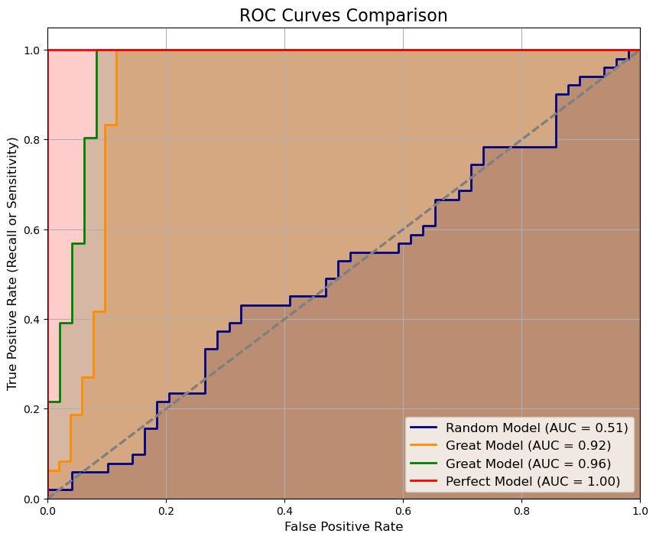
ROC AUC Score in Python

